Slide 1
Roger Sneath
DAF FutureBeef
Toowoomba
Excel spreadsheet - economics of sending cattle on agistment
This presentation is brought to you by GrazingFutures.
GrazingFutures is funded by the Queensland Government’s Drought
and Climate Adaptation Program (DCAP) that aims to improve drought
preparedness and resilience for Queensland producers.

Slide 2
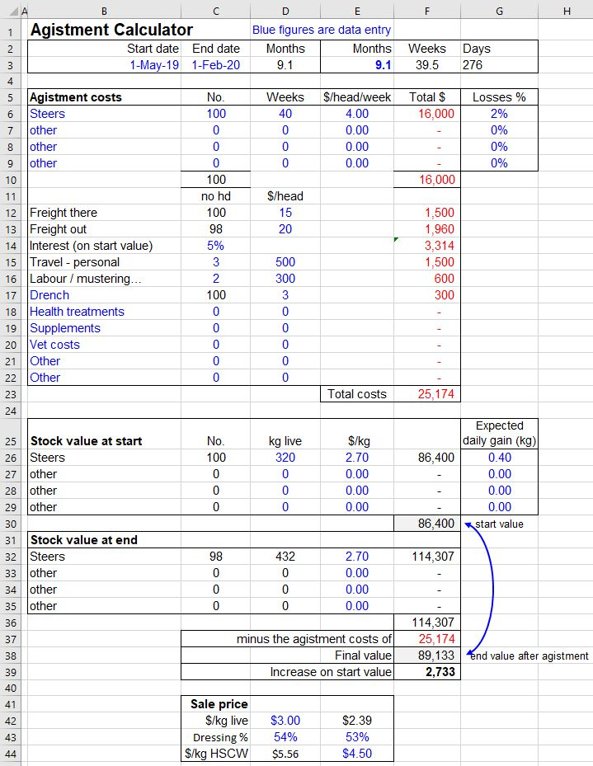
Agistment costs and returns
This is an excel calculator to test the economics of sending cattle on agistment.
Free download, search for:
Futurebeef business tools
Blue figures and blue words are data entry.
Black and red figures are formulas and are locked.
To make changes go to the ‘Review’ tab and unprotect.
No password.
Protect again when done.

Slide 3
Overall layout
Time period
Agistment costs
Stock start value
Stock performance (+/-)
Stock end value
Minus agistment costs
Final value
Profit or loss
$/kg live <-> $/kg CW conversion

Slide 4
1/5/19
Enter costs

Slide 5
Enter start live weight and value
Enter expected daily weight change (-/+)
Guesstimate final stock value
Stock end value – costs = final value
and profit or loss

Slide 6
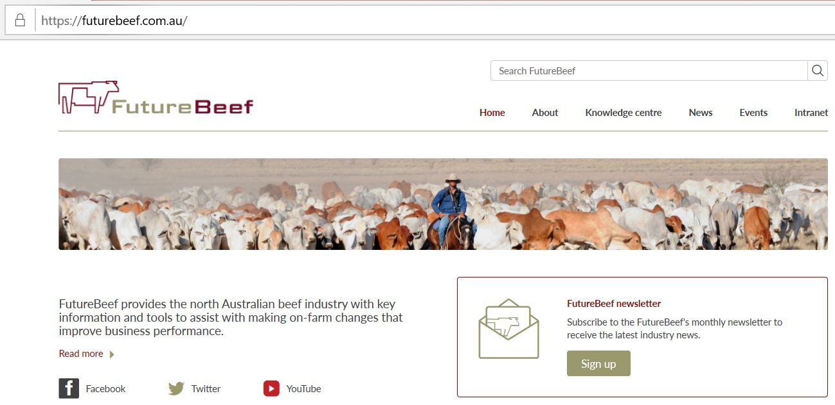
Search for:
Futurebeef business tools
Other calculators
Cattle feeding
Sell or feed
Marketing reckoner
Comparing feeds

